Slide 1
The Electronic Resource Activation Task List
Yoel Kortick
Senior Librarian

Slide 2

Agenda
Introduction
The two live examples
Live example #1
Live example #2
Manually creating an Electronic Resource Activation Task
Assigned and Unassigned Electronic Resources
Activation Task List Statuses
E-Resource Activation Action Options

Slide 3
Introduction

Slide 4
Introduction
After an electronic resource has been added to the inventory, the library may want to complete additional tasks prior to making the resource visible to patrons in discovery.
For example, the library will at some stage activate the resource and may also want to edit the resource and / or test the access to the e-resource.
These tasks may be handled through the options provided by the Electronic Resource Activation Task List.
Resources that were ordered (via a Purchase Order Line in Alma) from Community Zone are automatically added to the Electronic Resource Activation Task List.
Electronic resources are automatically added to the Electronic Resource Activation Task List page if they are ordered from the Community Zone or Institution Zone.
Electronic resources are not automatically added if the staff user selects the “Activate” link from the Community Zone instead of selecting “Order”.

Slide 5
Introduction
The full workflow of the process involving the Activation Task List (starting from ordering electronic resources in Alma, activating it, discovering it in discovery system, and then accessing it via Link Resolver) is as follows:
Create a POL for the resource from the CZ (or from the institution)
Receive confirmation from the vendor that access to the resource is enabled for the institution
Test the link to the e-resource via the Electronic Resource Activation Task List (this step can be performed at any stage in the process)
Search for the activated resource in discovery (to see the situation from an end user’s perspective).
In discovery, after finding the resource, click “Available Online” to view the options and confirm access.

Slide 6
Introduction
To manage electronic resource activation, the staff user must have one of the following roles:
  Electronic Inventory Operator
  Repository Manager
I addition to this presentation see also Activating Electronic Resources and the Activation Task List .

Slide 7
The two live examples

Slide 8
The two live examples
We will now do two live examples showing the creation of a task in the Electronic Resource Activation Task List after creating a POL for an electronic collection from the Community Zone
In both cases we will go through the full flow of creating the order, viewing the task in the Electronic resource Activation Task List, activating the resource, confirming that access works, and viewing the resource as an end user in discovery.
In the first example we will test access to the resource from the Electronic resource Activation Task List before activating the resource.
In the second example we will test access to the resource from the Electronic resource Activation Task List after activating the resource.

Slide 9
The two live examples
The activation of the resource makes the resource be available (appear) in discovery and is done by the staff user in Alma.
The access to the resource allows the institution to use (access) the resource and is done by the vendor.
For various internal institution flows, the institution may want to
  Make the resource available (appear) in discovery even before it is accessible to the end user in discovery
  Make the resource available (appear) in discovery only after testing the access and making sure it is accessible.

Slide 10
Live example # 1

Slide 11
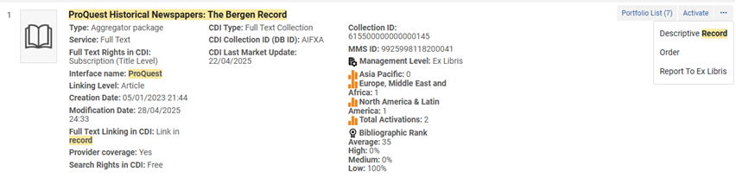
Live example # 1
We will now place an acquisitions order (POL) for electronic collection “ProQuest Historical Newspapers: The Bergen Record” from the Community Zone

Slide 12
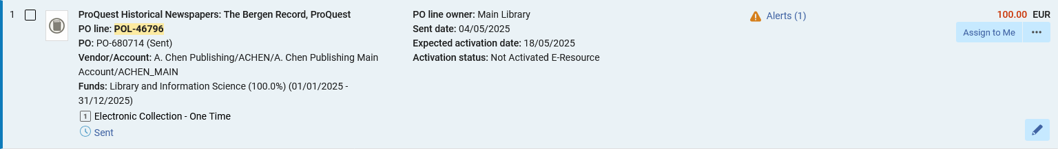
Live example # 1
POL-46796 is created for electronic collection “ProQuest Historical Newspapers: The Bergen Record”.
The resource is not activated

Slide 13
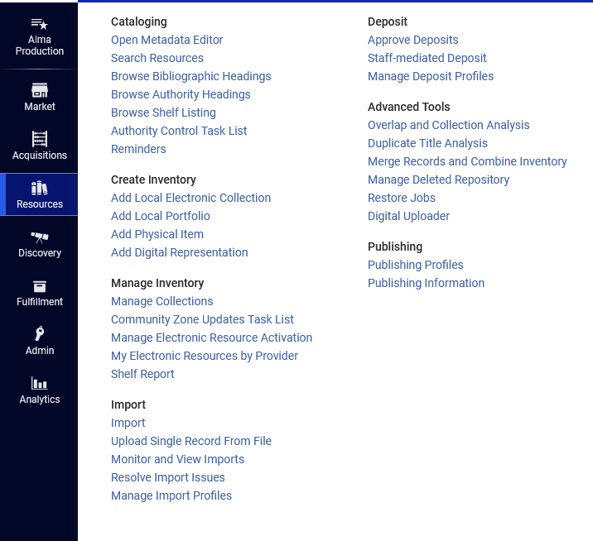
Live example # 1
One way to access the Electronic Resource Activation Task List is via the Alma menu at “Resources > Manage Inventory > Manage Electronic Resource Activation”

Slide 14
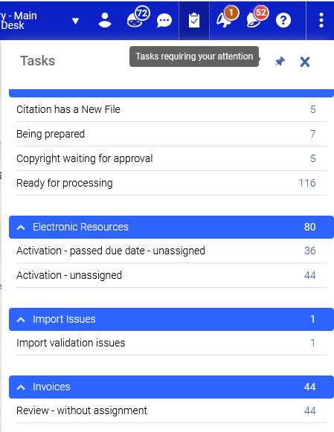
Live example # 1
Another way to access the Electronic Resource Activation Task List is via the “Tasks requiring your attention” icon

Slide 15
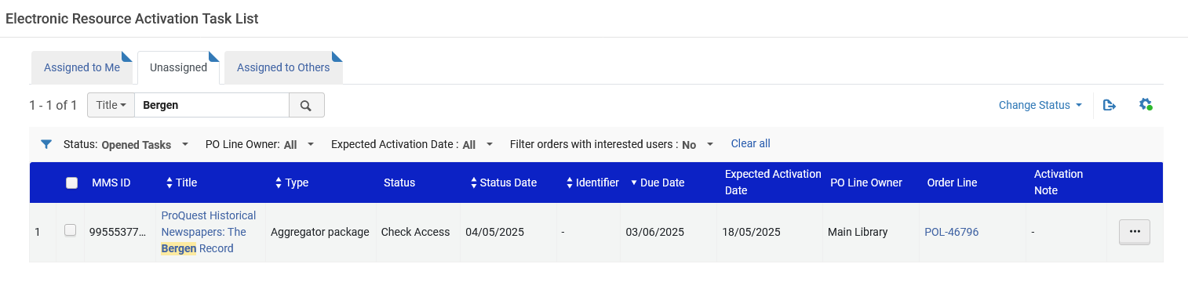
Live example # 1
Because the electronic resource was created via the creation of a POL, a task is automatically created in the Electronic resource Activation Task List.
When a new task is created it automatically goes to the “Unassigned” tab.
After a user does any activity on the task it will move to his or her “Assigned to Me” tab.

Slide 16
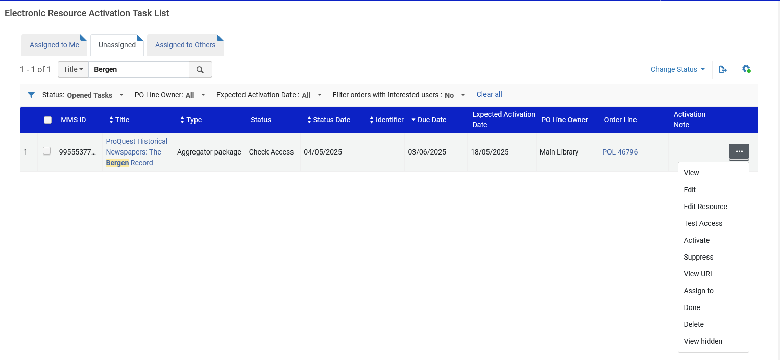
Live example # 1
From the Electronic resource Activation Task List various activities can be performed on the electronic resource

Slide 17
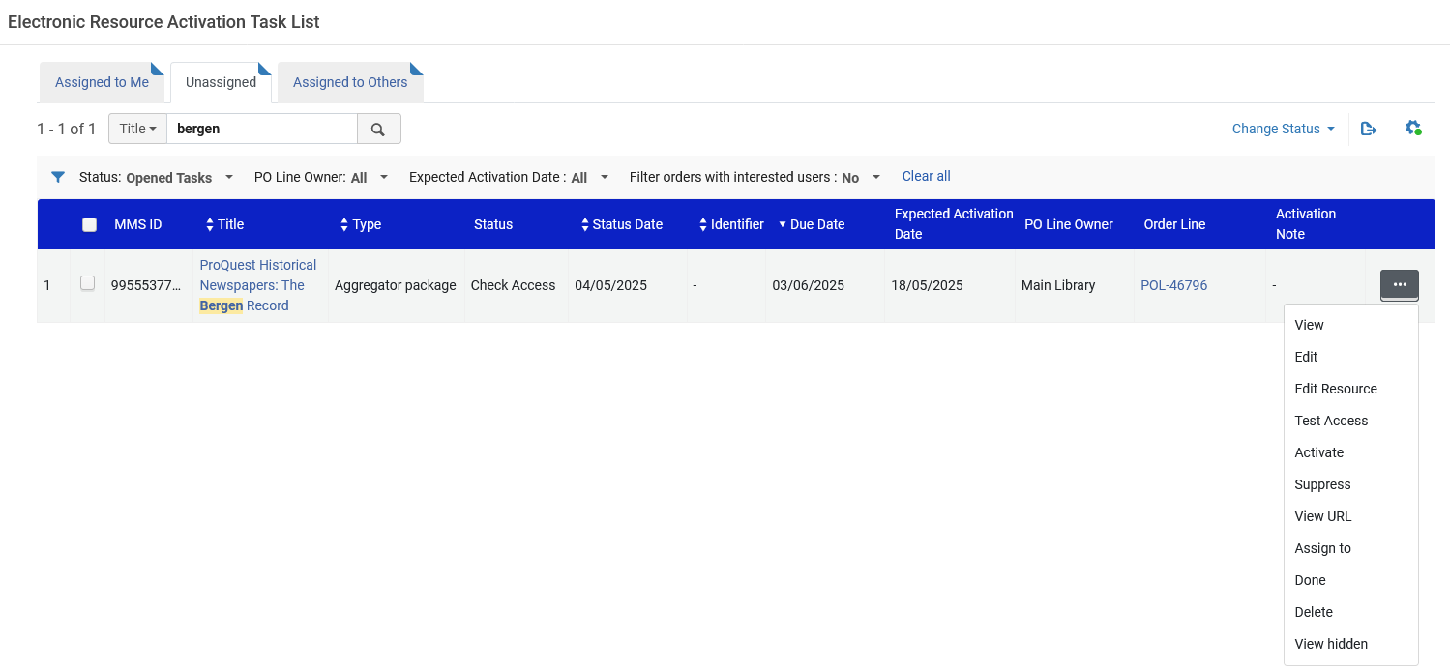
Live example # 1
Before we activate the electronic resource we will “test access”.

Slide 18
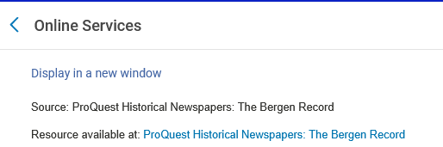
Live example # 1
We are presented with the services page, and we will click the link for “ProQuest Historical Newspapers: The Bergen Record”

Slide 19
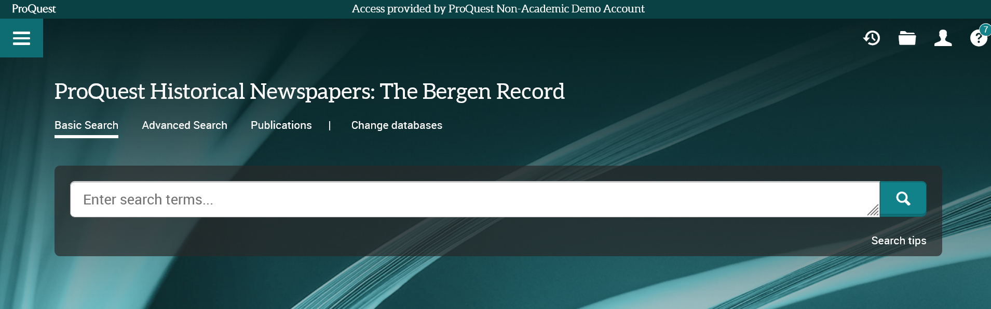
Live example # 1
We see that we do have access.

Slide 20
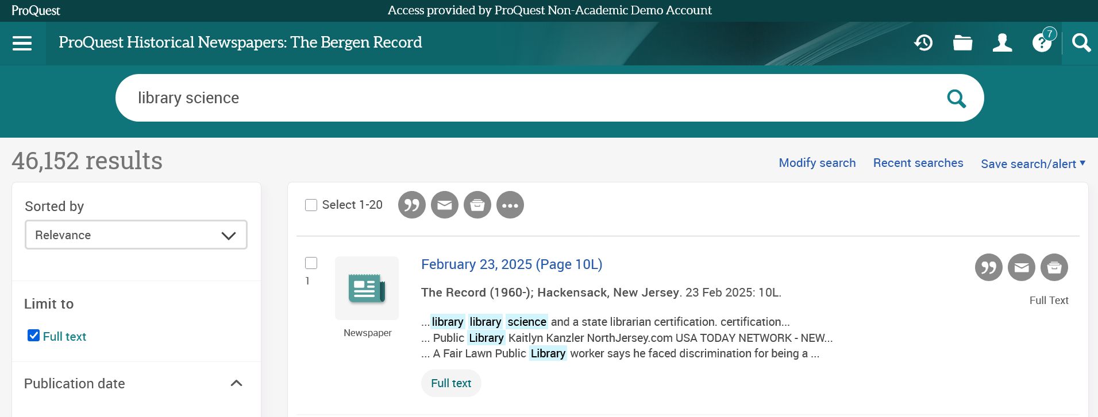
Live example # 1
If we “really want to make sure” that we have access, we can perform a search in the electronic collection

Slide 21
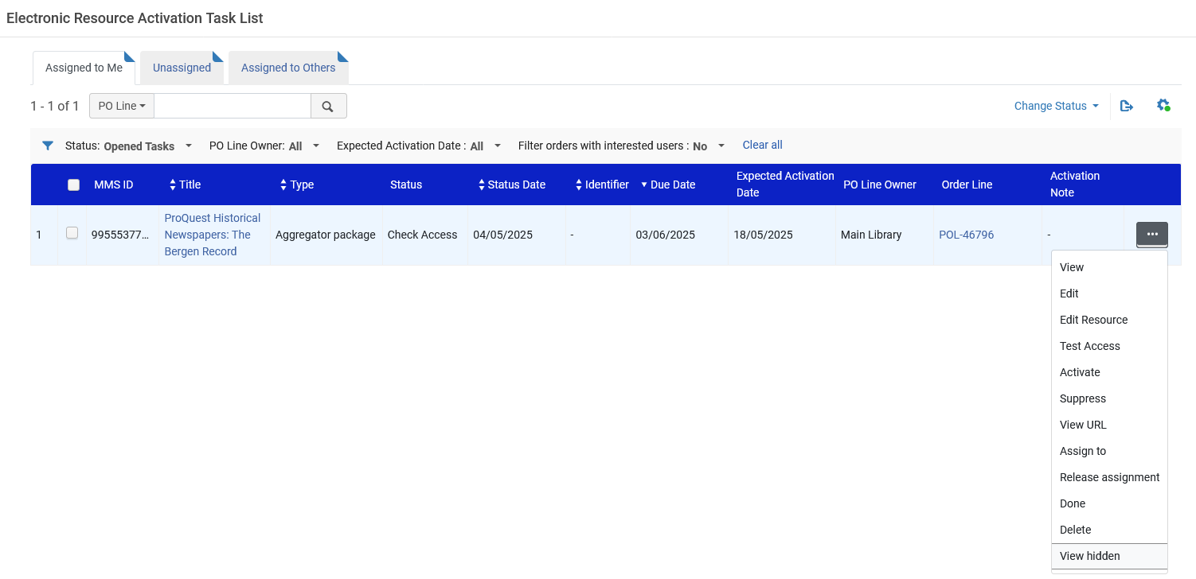
Live example # 1
We will now activate the electronic resource. This will make it available to the end user in discovery.
Note that now the task is in the “Assigned to Me” tab because I (the logged in user) worked on the task (when testing access)

Slide 22
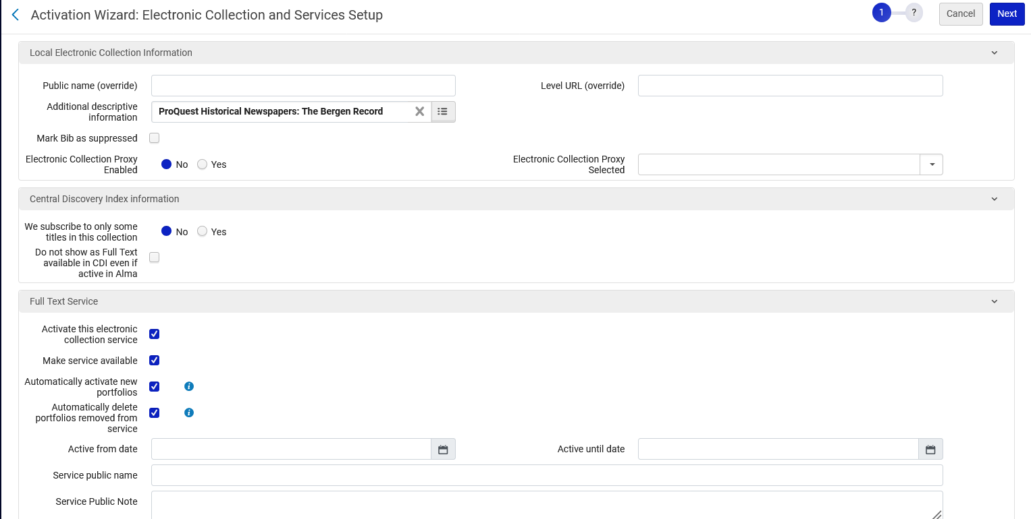
Live example # 1
The Activation Wizard opens
By default, “Mark Bib as suppressed” is checked. We have unchecked it.
We have checked all boxes in the “Full Text Service” section.

Slide 23
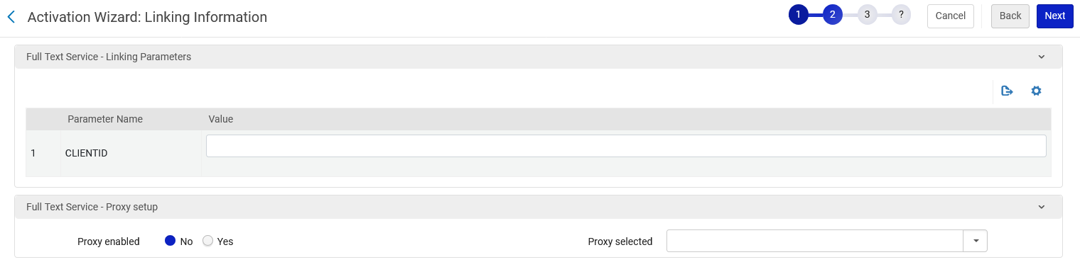
Live example # 1
In our example we will not add a client ID or enable a proxy

Slide 24
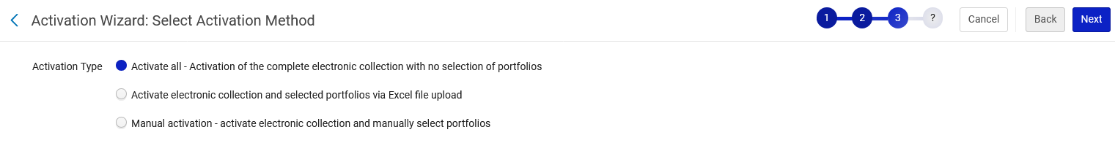
Live example # 1
For the “Activation Type” we will choose “Activate all – Activation of the complete electronic collection with no selection of portfolios”

Slide 25
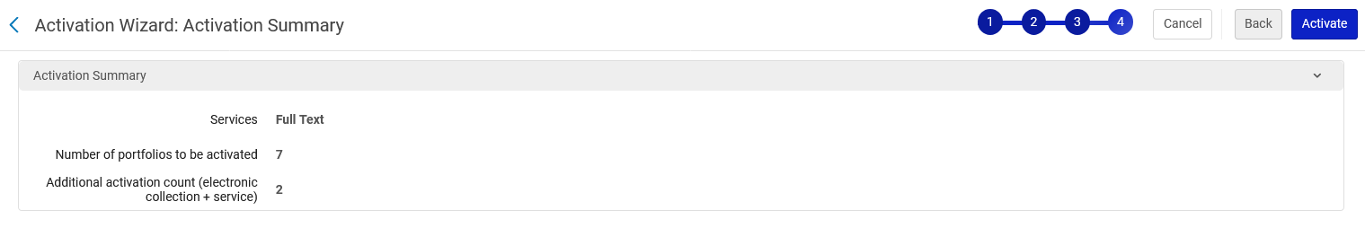
Live example # 1
We are presented with the “Activation Summary” and will activate.

Slide 26
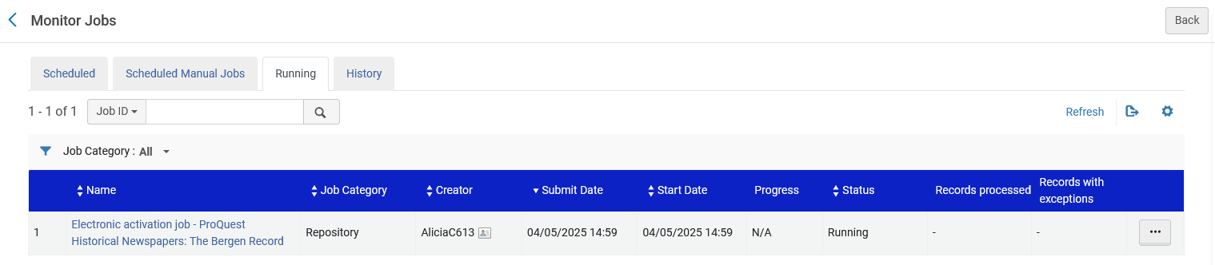
Live example # 1
The Electronic Activation job runs

Slide 27
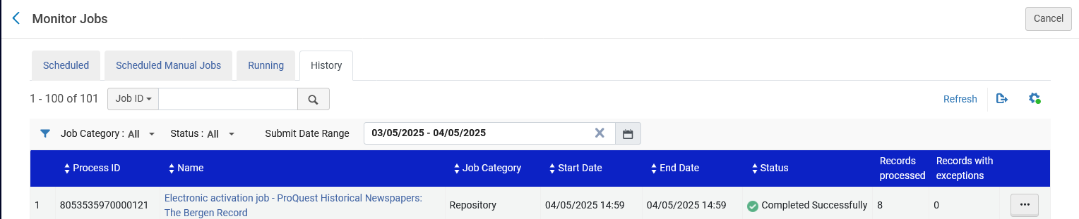
Live example # 1
The Electronic Activation job completes

Slide 28
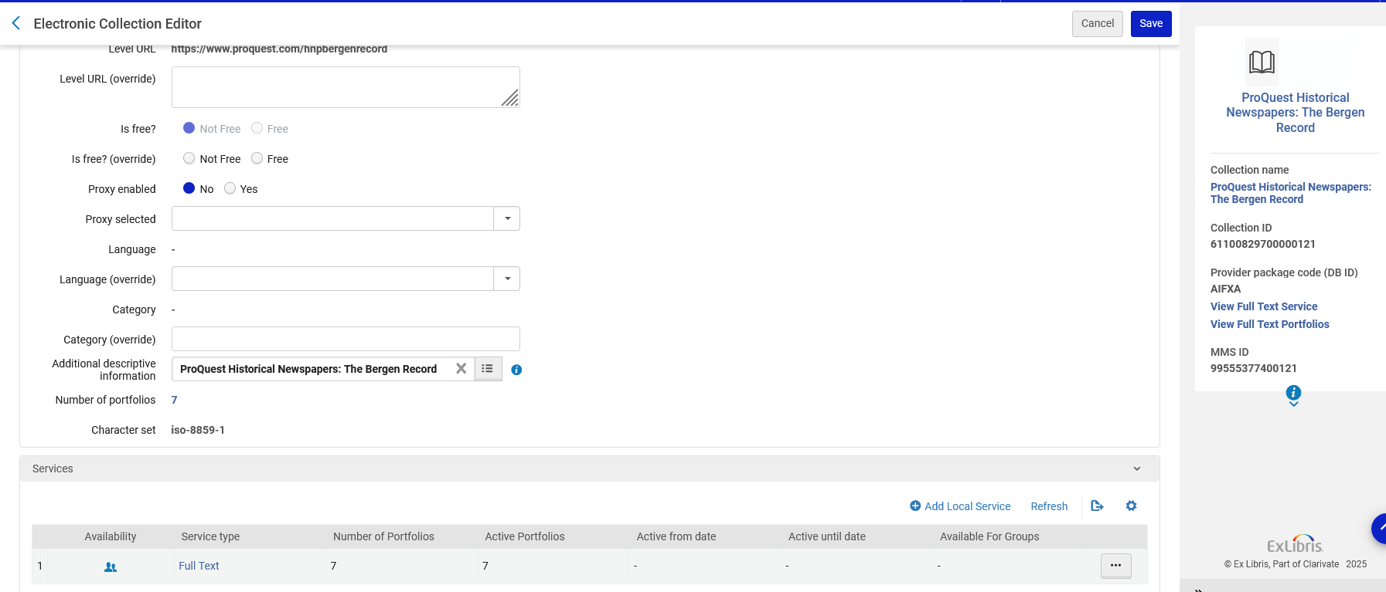
Live example # 1
The Electronic Collection now has an active service

Slide 29
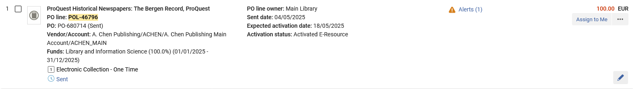
Live example # 1
We also see in the POL that the resource is activated

Slide 30
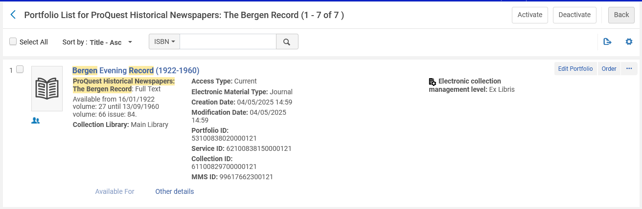
Live example # 1
Let’s see how one of the portfolios in the electronic collection appears to the end user in discovery and confirm that there is access (even though we already tested access before activating)
Portfolio “Bergen Evening Record (1922-1960)” is in the electronic collection “
ProQuest Historical Newspapers: The Bergen Record”

Slide 31
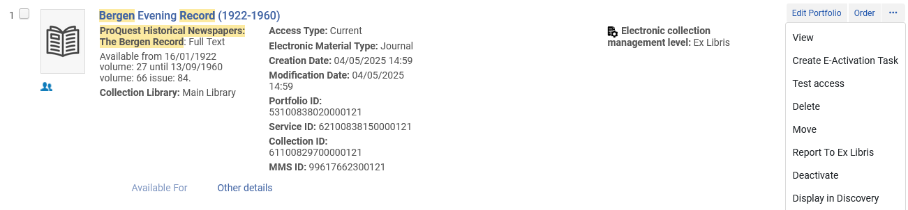
Live example # 1
We will display this portfolio in discovery and confirm that there is access and see how it will appear to the end user.

Slide 32
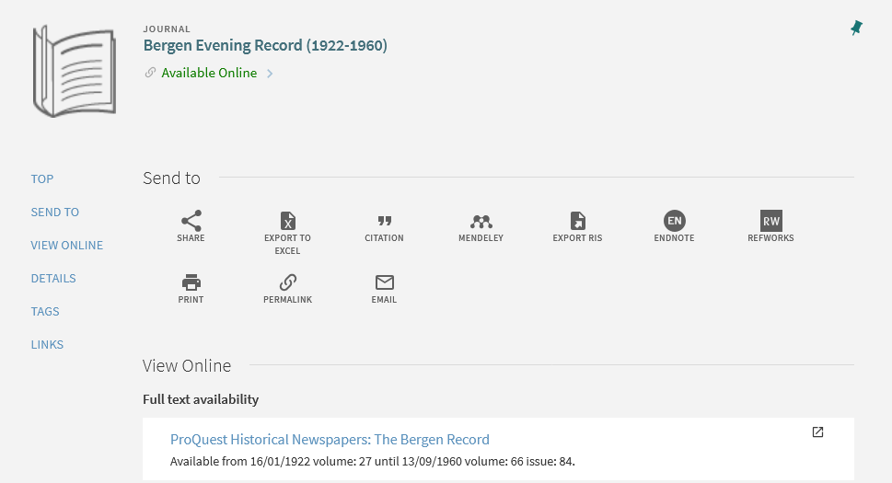
Live example # 1
In discovery we will click the link for “ProQuest Historical Newspapers: The Bergen Record”

Slide 33
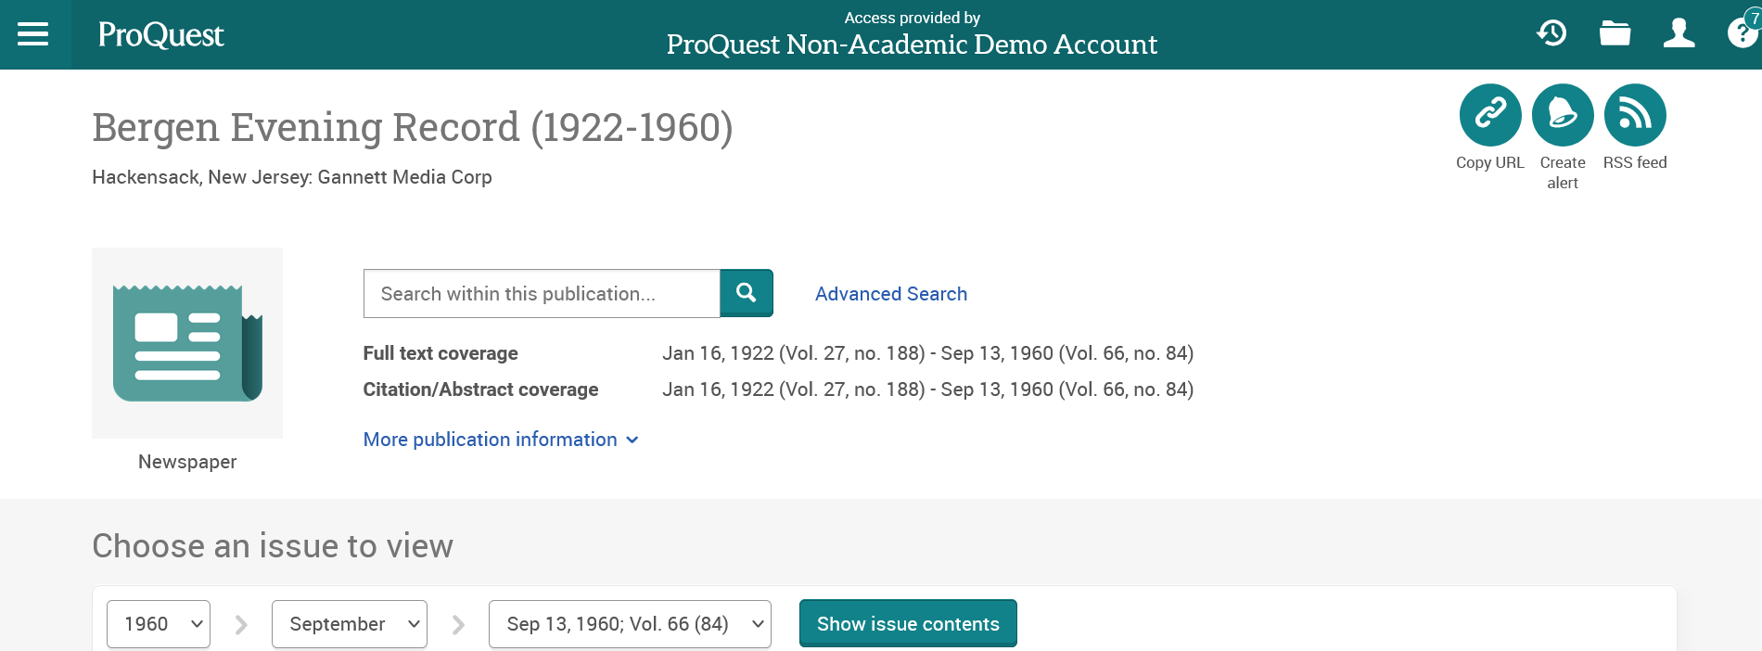
Live example # 1
We see that the link works and brings the end user in discovery to the correct page

Slide 34
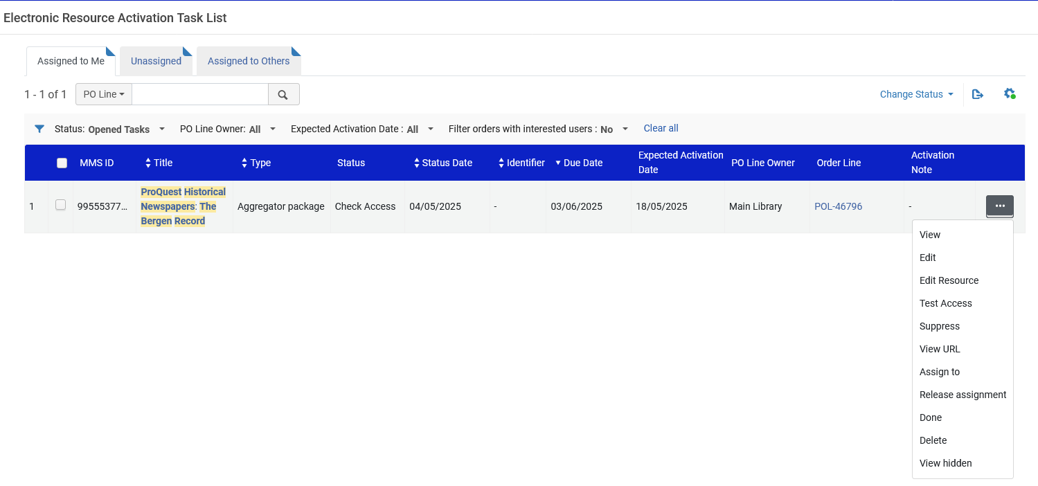
Live example # 1
From the Electronic Resource Activation Task List, we can now change the task to “Done”

Slide 35
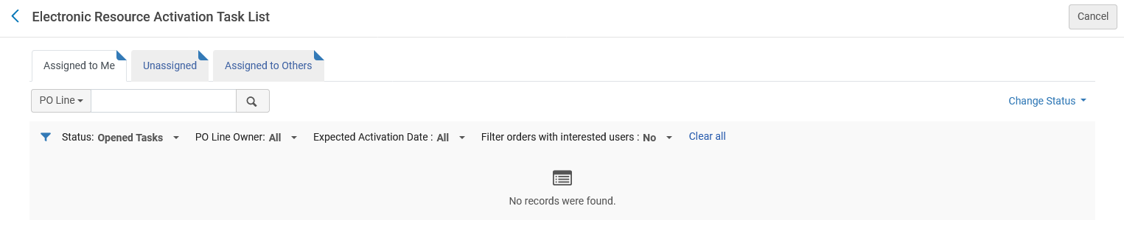
Live example # 1
The task is complete

Slide 36
Live example # 2

Slide 37
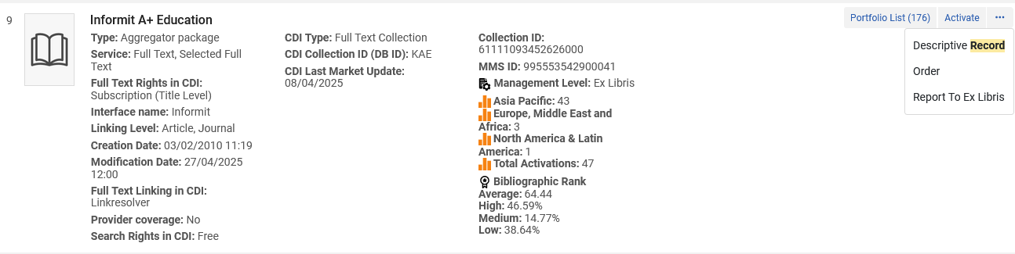
Live example # 2
We will now place an acquisitions order (POL) for electronic collection “Informit A+ Education” from the Community Zone

Slide 38
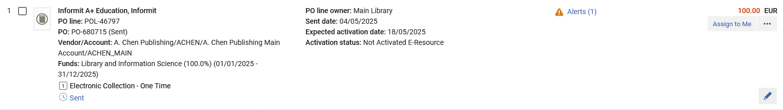
Live example # 2
POL-46797 is created for electronic collection “Informit A+ Education”.
The resource is not activated

Slide 39
Live example # 2
One way to access the Electronic Resource Activation Task List is via the Alma menu at “Resources > Manage Inventory > Manage Electronic Resource Activation”

Slide 40
Live example # 2
Another way to access the Electronic Resource Activation Task List is via the “Tasks requiring your attention” icon

Slide 41
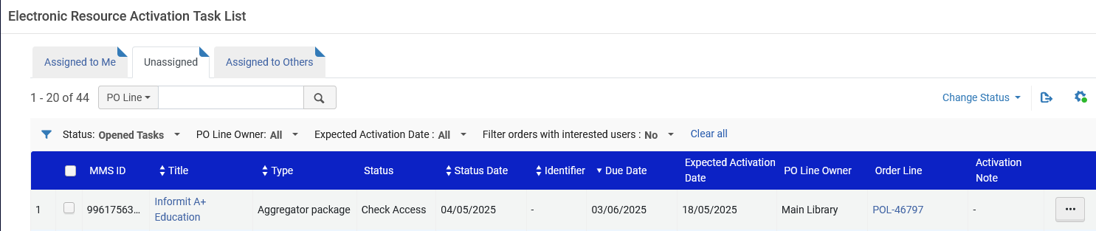
Live example # 2
Because the electronic resource was created via the creation of a POL, a task is automatically created in the Electronic resource Activation Task List.
When a new task is created it automatically goes to the “Unassigned” tab.
After a user does any activity on the task it will move to his or her “Assigned to Me” tab.

Slide 42
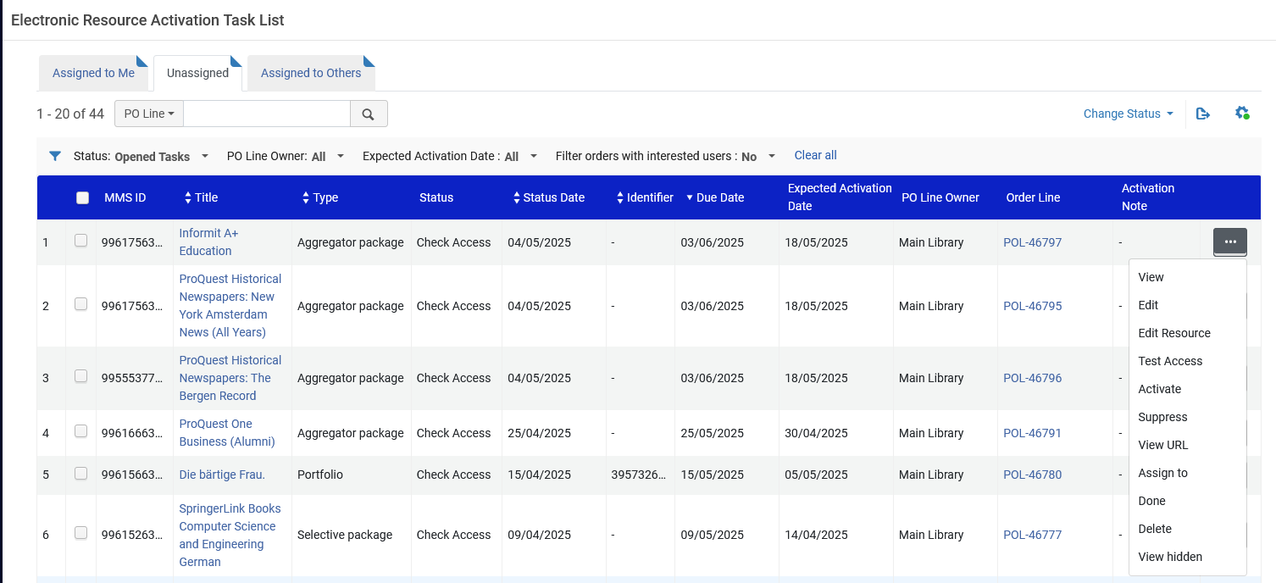
Live example # 2
From the Electronic resource Activation Task List various activities can be performed on the electronic resource

Slide 43
Live example # 2
We will now activate the electronic resource. This will make it available to the end user in discovery.

Slide 44
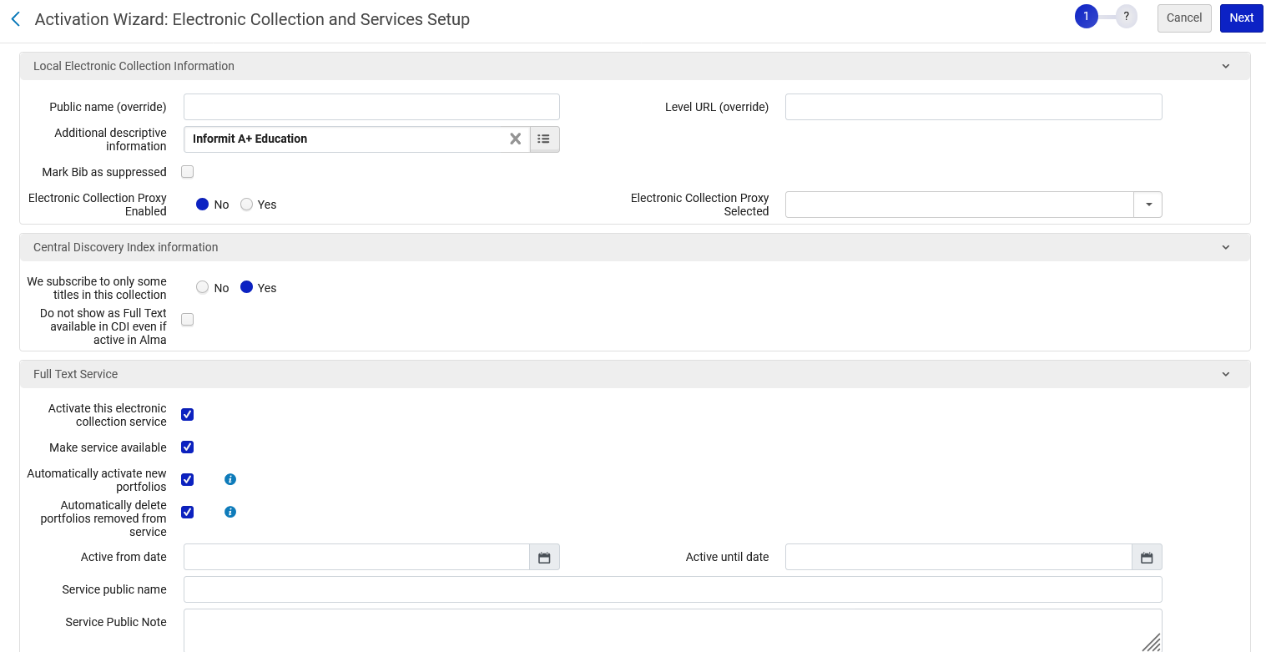
Live example # 2
The Activation Wizard opens
By default, “Mark Bib as suppressed” is checked. We have unchecked it.
We have checked all boxes in the “Full Text Service” section.

Slide 45
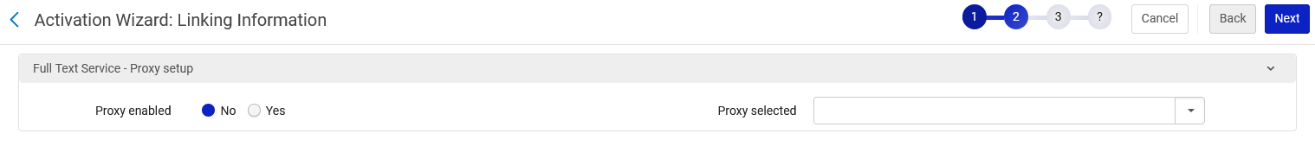
Live example # 2
In our example we will not enable a proxy

Slide 46
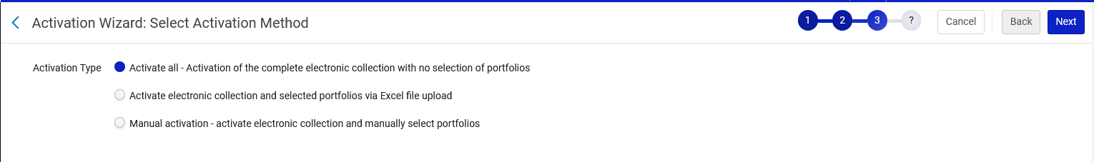
Live example # 2
For the “Activation Type” we will choose “Activate all – Activation of the complete electronic collection with no selection of portfolios”

Slide 47
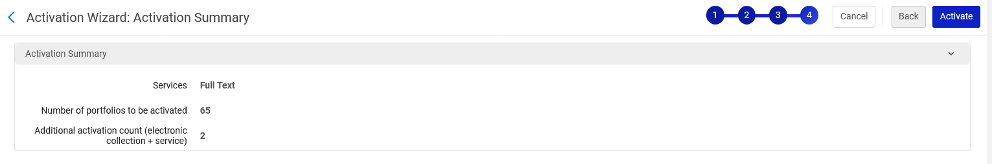
Live example # 2
We are presented with the “Activation Summary” and will activate.

Slide 48
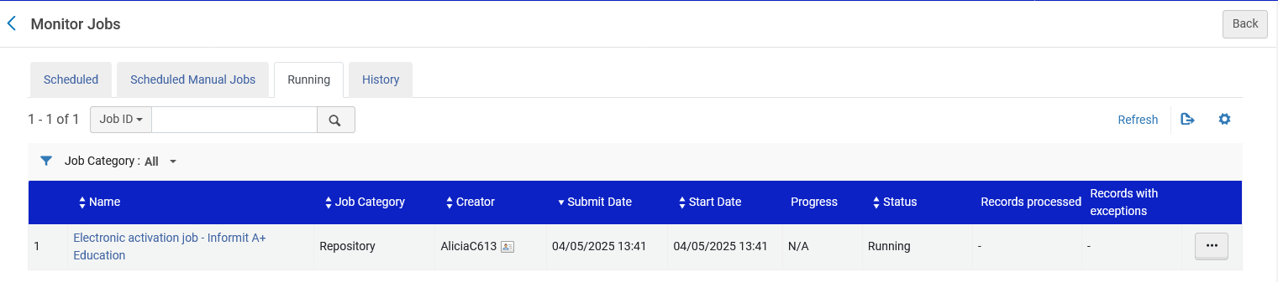
Live example # 2
The Electronic Activation job runs

Slide 49
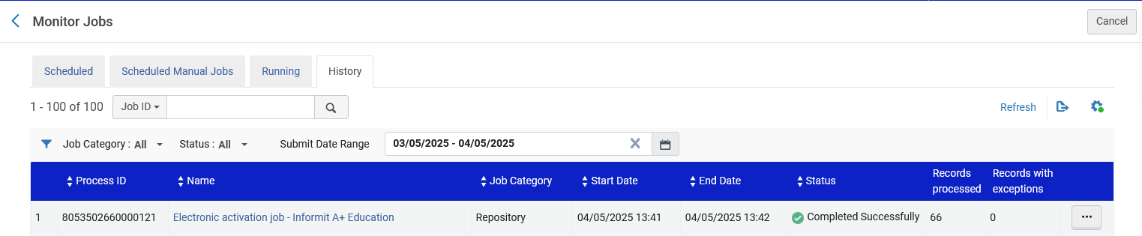
Live example # 2
The Electronic Activation job completes

Slide 50
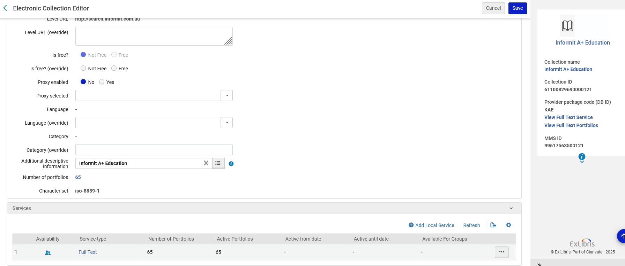
Live example # 2
The Electronic Collection now has an active service

Slide 51
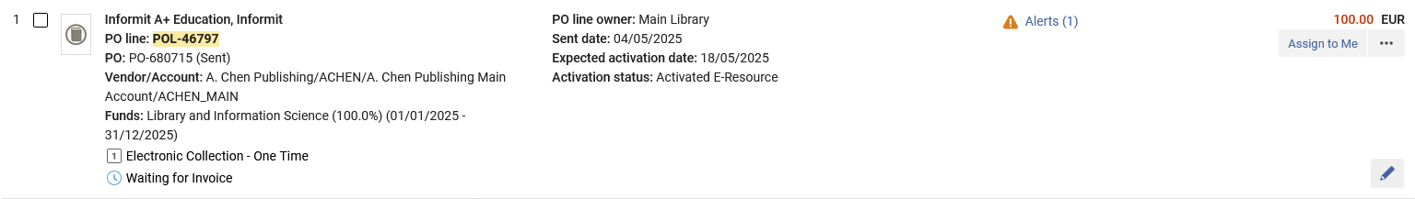
Live example # 2
We also see in the POL that the resource is activated

Slide 52
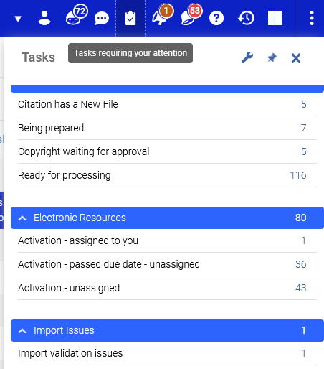
Live example # 2
The Task in the Electronic Resource Activation Task list is now assigned to the staff user who worked on the task (in this case the staff user activated the resource)

Slide 53
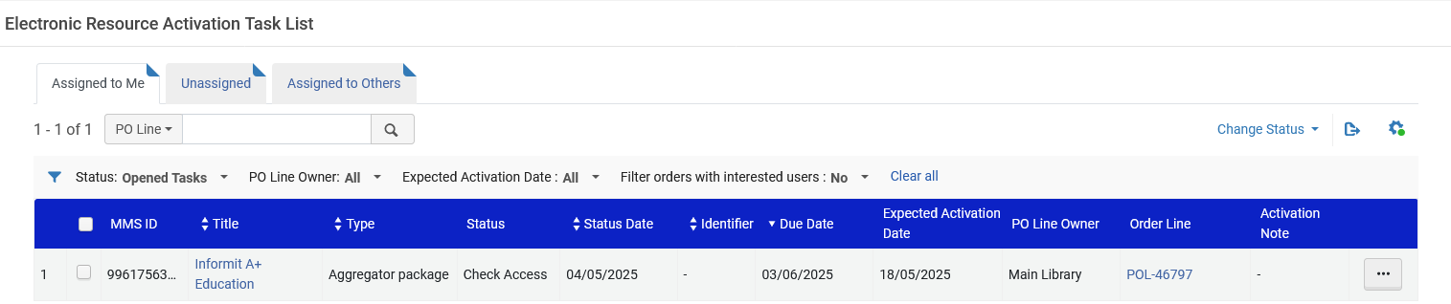
Live example # 2
The Task in the Electronic Resource Activation Task appears in the “Assigned to Me” tab.

Slide 54
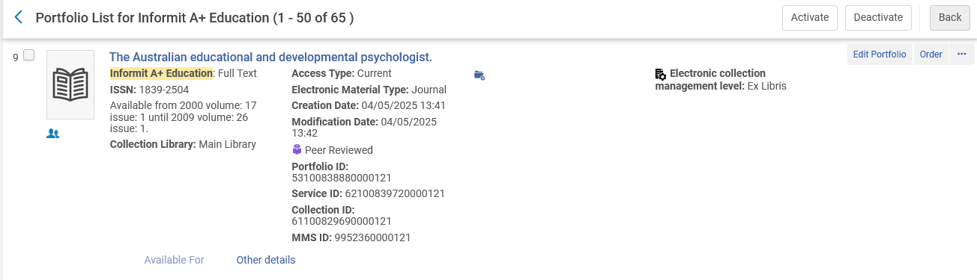
Live example # 2
Let’s test access by searching for one of the portfolios in this electronic collection in discovery and confirm that there is access
Portfolio “The Australian educational and developmental psychologist” is in the electronic collection “Informit A+ Education”

Slide 55
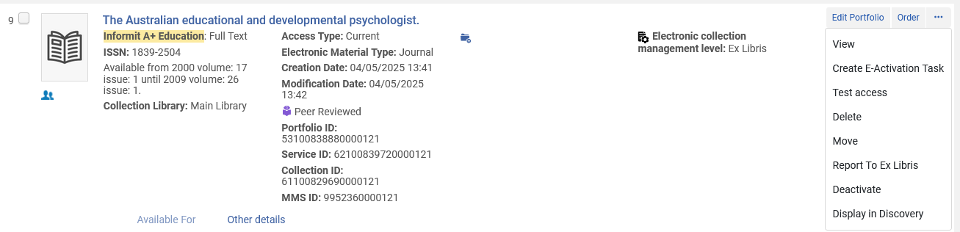
Live example # 2
We will display this portfolio in discovery and confirm that there is access and see how it will appear to the end user.

Slide 56
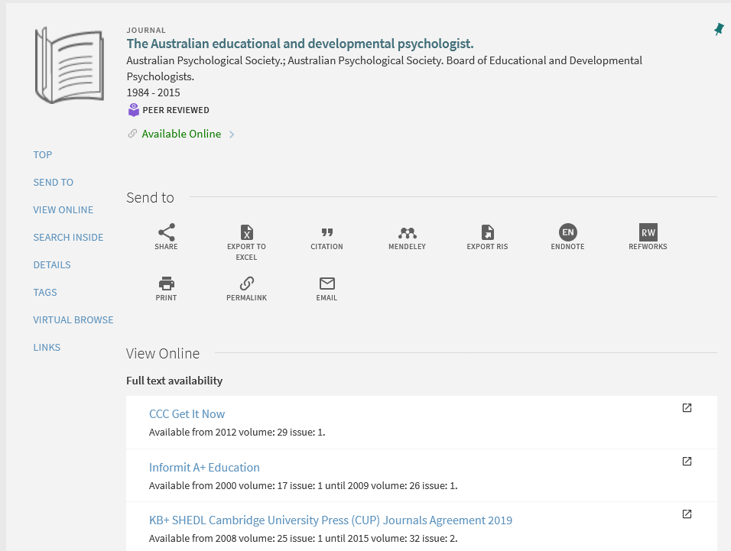
Live example # 2
In discovery we will click the link for “Informit A+ Education”

Slide 57

Live example # 2
We see that the link works and brings the end user in discovery to the correct page

Slide 58
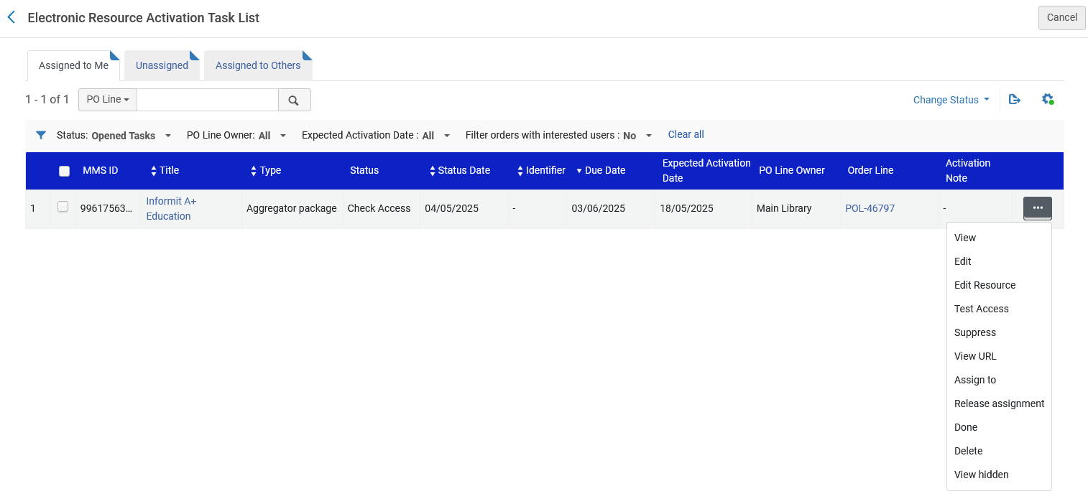
Live example # 2
From the Electronic Resource Activation Task List, we can now change the task to “Done”

Slide 59
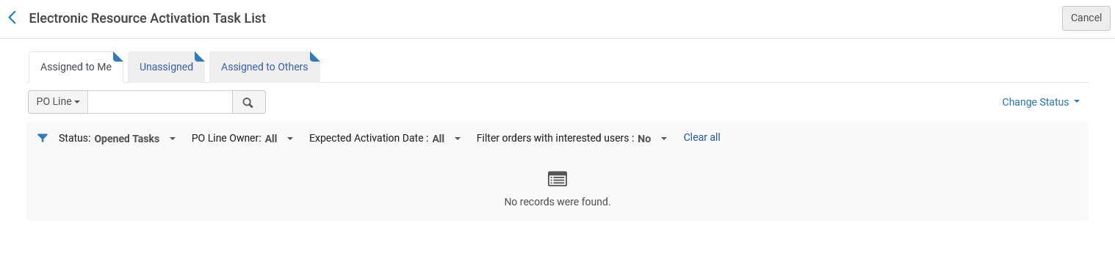
Live example # 2
The task is complete

Slide 60
Manually creating an Electronic Resource Activation Task

Slide 61
Manually creating an Electronic Resource Activation Task
In both of our previous examples we first created a POL for an electronic resource from the Community Zone and this automatically created an Electronic Resource Activation Task.
It is also possible to use the Electronic Resource Activation Task List for electronic resources which
  Are not created via a POL for an electronic resource from the Community Zone.
  Are created via a POL for an electronic resource from the Community Zone but the task in the Electronic Resource Activation Task list has been removed.
The institution may have electronic resources in the repository which, for whatever reason, are not activated. In these cases, an Electronic Resource Activation Task can be created, thereby allowing the staff user to take advantage of the functionality of the Electronic Resource Activation Task list

Slide 62
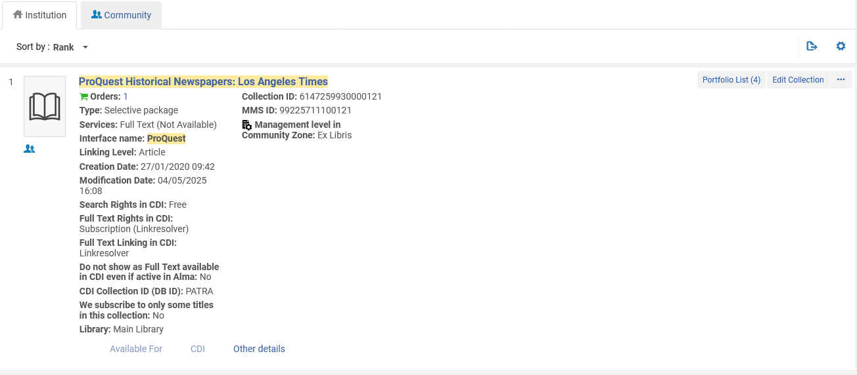
Manually creating an Electronic Resource Activation Task
Here is electronic resource “ProQuest Historical Newspapers: Los Angeles Times” in the institution.
It has a “Full Text Service” which is not activated (not available).

Slide 63
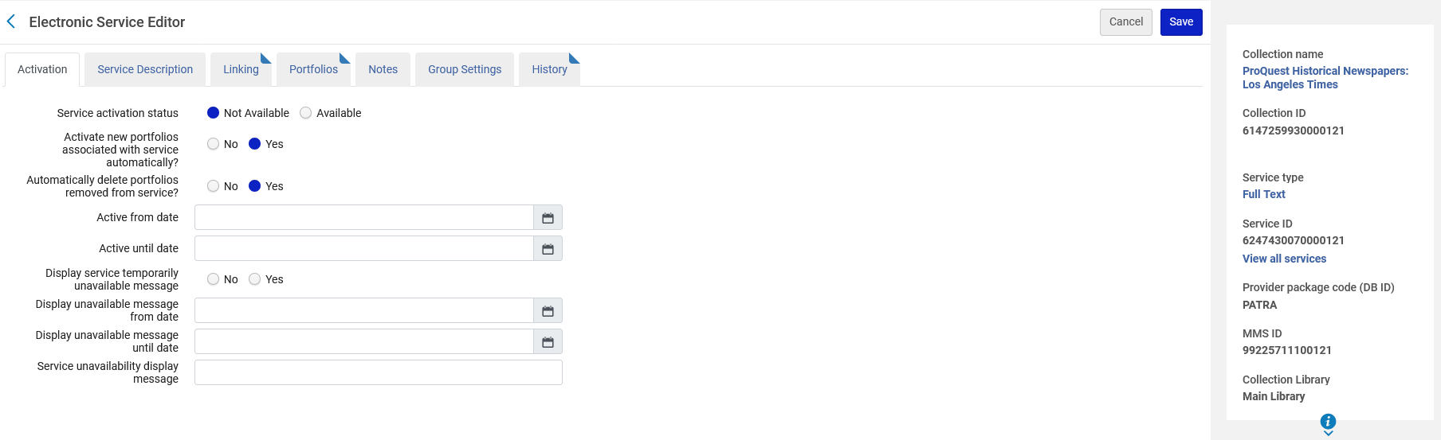
Manually creating an Electronic Resource Activation Task
The service activation status is not available (not activated).

Slide 64
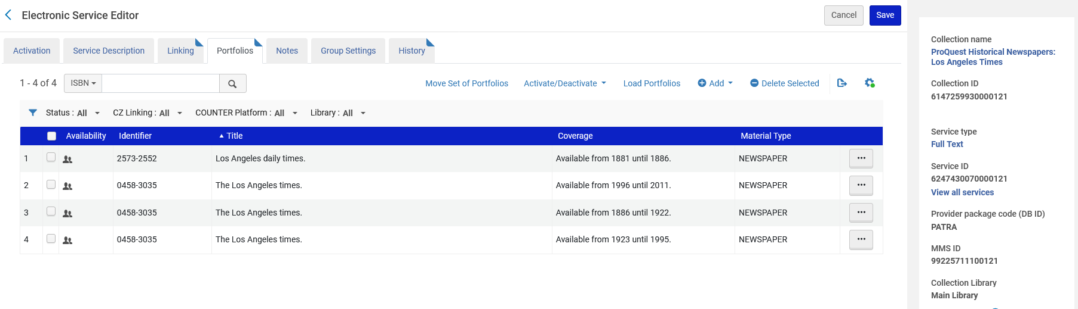
Manually creating an Electronic Resource Activation Task
All portfolios in the electronic collection are not activated

Slide 65
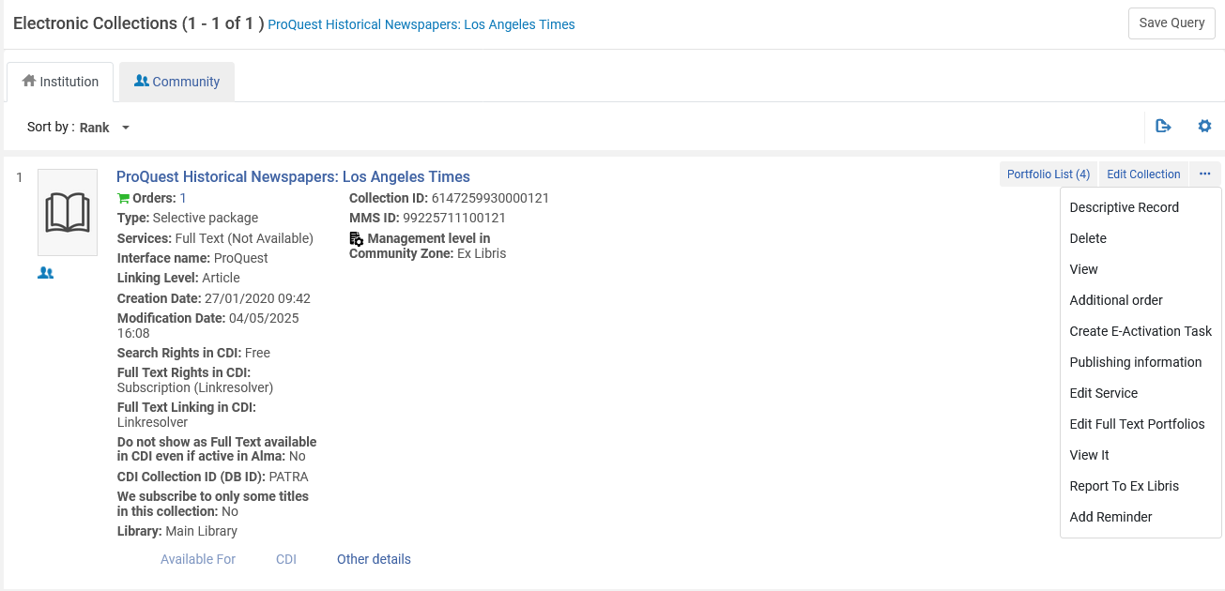
Manually creating an Electronic Resource Activation Task
For the action items of the electronic resource, we can create a task for the Electronic resource Activation Task List:

Slide 66
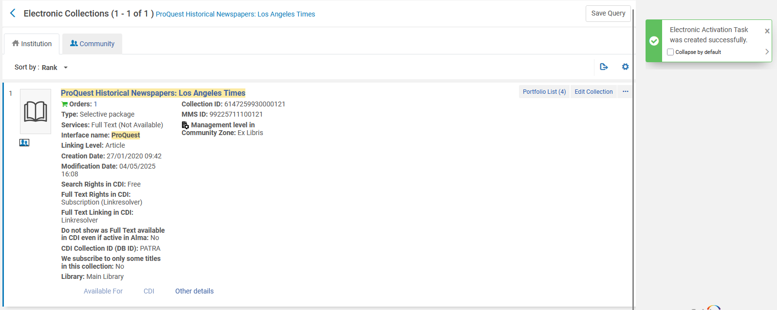
Manually creating an Electronic Resource Activation Task
We receive a message that the E-Activation task was created

Slide 67
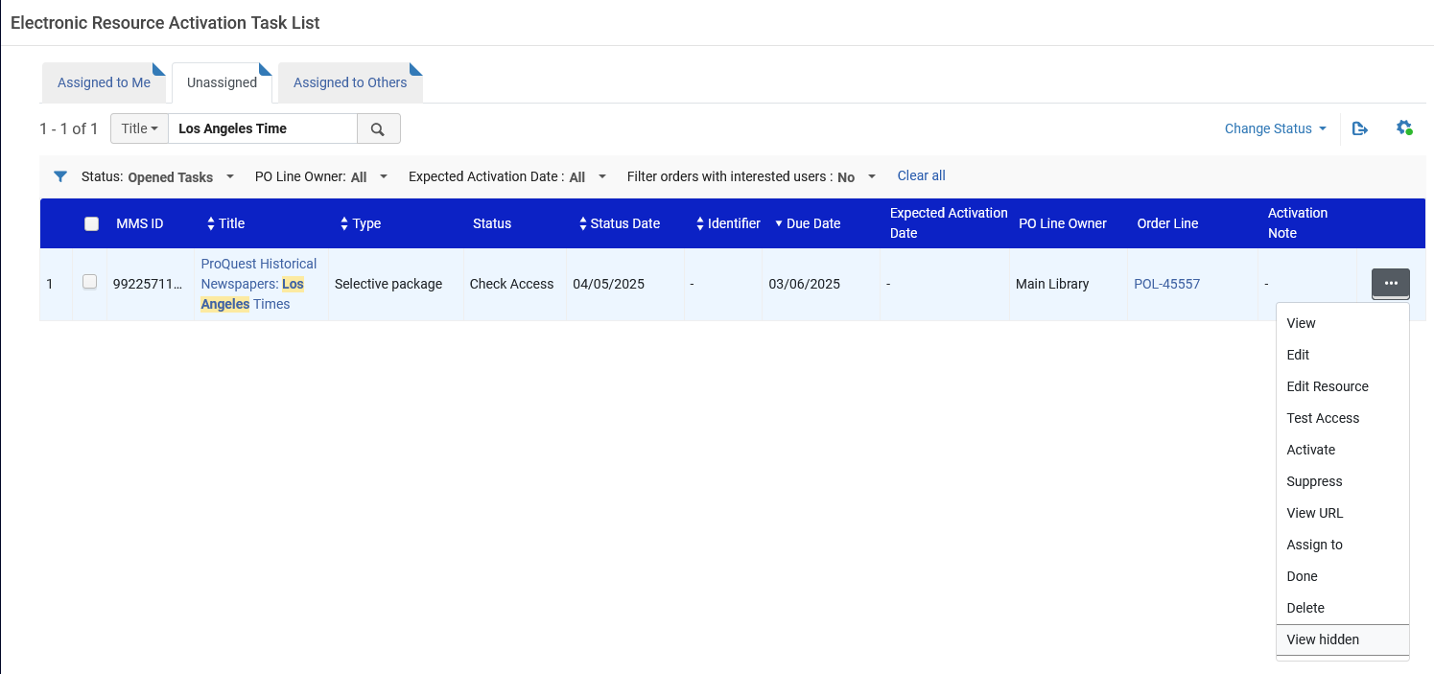
Manually creating an Electronic Resource Activation Task
We see that the E-Activation Task was created and appears in the “Unassigned” tab.
We will activate the resource

Slide 68

Manually creating an Electronic Resource Activation Task
We receive this message and choose not to edit the resource (and therefore click “Cancel”)

Slide 69

Manually creating an Electronic Resource Activation Task
We see now that the full text service is available (active)

Slide 70

Manually creating an Electronic Resource Activation Task
We see now that the full text service is available (active)

Slide 71

Manually creating an Electronic Resource Activation Task
We see now that all portfolios in the collection are active

Slide 72

Manually creating an Electronic Resource Activation Task
We will check the access of one of the portfolios in the collection in discovery

Slide 73

Manually creating an Electronic Resource Activation Task
The end user in discovery has access

Slide 74

Manually creating an Electronic Resource Activation Task
From the Electronic Resource Activation Task List, we can now change the task to “Done” and it will no longer appear in the task list

Slide 75
Assigned and Unassigned Electronic Resources

Slide 76
Assigned and Unassigned Electronic Resources
As we saw in the previous examples, Activation of electronic resources is done on the Electronic Resource Activation Task List page.
We also saw that when a staff user does an activity on a task from the “Unassigned” tab the task automatically becomes assigned to that staff user.
On this page, an electronic resource can either be assigned to a specific user for editing or it can be unassigned.

Slide 77

Assigned and Unassigned Electronic Resources
Assign to a specific user from the “Unassigned” tab

Slide 78

Assigned and Unassigned Electronic Resources
Assign to a specific user from the “Assigned to me” tab
Release assignment from the “Assigned to me” tab

Slide 79
Assigned and Unassigned Electronic Resources
Assigned: Only the staff user to whom the task is assigned can work on the task. A task is assigned to a staff user in either of the following two ways:
  by another staff user
  from the “unassigned” tab whereby after doing any activity on the task it is assigned to the staff user who did any activity on it
Unassigned: Any staff person can edit unassigned electronic resources.

Slide 80
Activation Task List Statuses

Slide 81

Activation Task List Statuses
It is possible to edit an electronic resource activation task and change the status

Slide 82

Activation Task List Statuses
It is possible to edit an electronic resource activation task and change the status

Slide 83

Activation Task List Statuses
The tasks can then be filtered by a specific status

Slide 84
Activation Task List Statuses
There are three default “out of the box” statuses for Electronic Resource Activation tasks supplied with Alma”
  Access Confirmed
  Check Access
  Not Yet Online

Slide 85

Activation Task List Statuses
The statuses can be edited, allowing new statuses to be added, via “Configuration > Resources > General > E-Task Statuses”. Here is the default table:
New statuses can be added here

Slide 86

Activation Task List Statuses
These are the three default statuses
These are statuses added by the institution

Slide 87

Activation Task List Statuses
These are the three default statuses
These are statuses added by the institution

Slide 88
E-Resource Activation Action Options

Slide 89

E-Resource Activation Action Options
Various functions can be performed on Electronic resource Activation Tasks

Slide 90
E-Resource Activation Action Options
Rather than detailing here in the PowerPoint the various options for the Electronic resource Activation tasks the reader is referred to the table “E-Resource Activation Action Options” at Activating Electronic Resources and the Activation Task List

